Slide 1
Azure Data Lake Store
[Speaker Name]

Slide 2
“A single store of all data… ranging from raw data (which implies exact copy of source system data) to transformed data which is used for various forms including reporting, visualization, analytics, and machine learning”

Slide 3
Azure Databricks
Designed in collaboration with the founders of Apache Spark
One-click set up; streamlined workflows
Interactive workspace that enables collaboration between data scientists, data engineers, and business analysts.
Native integration with Azure services (Power BI, SQL DW, Cosmos DB, Blob Storage)
Enterprise-grade Azure security (Active Directory integration, compliance, enterprise -grade SLAs)

Slide 4
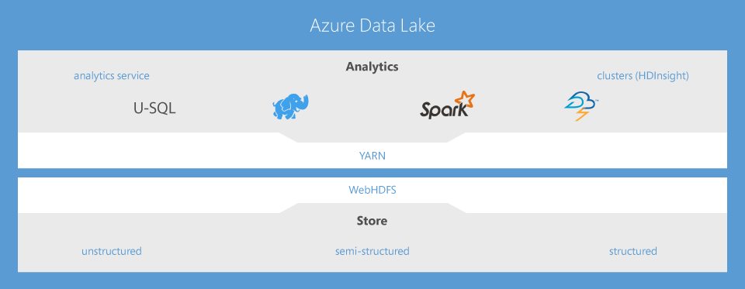
Built on Open-Source

Slide 5
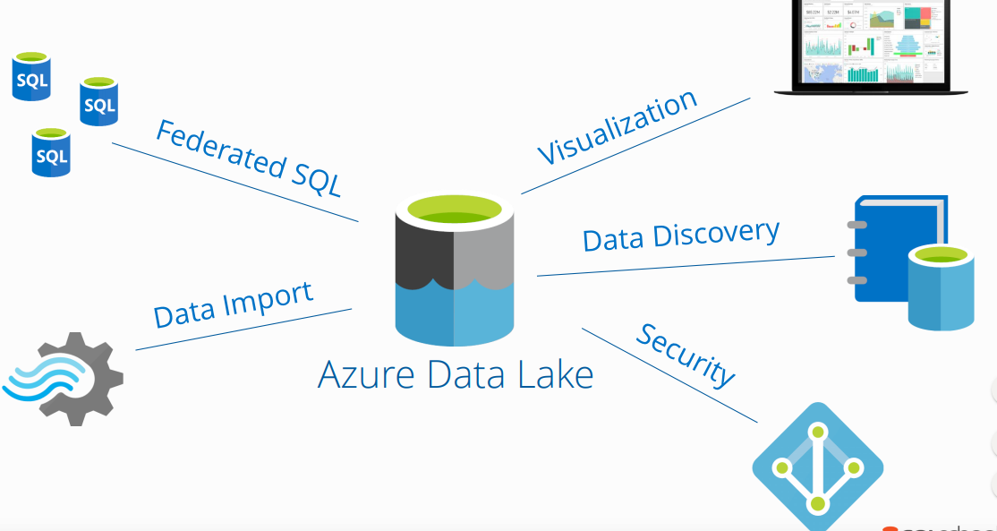
Azure Ecosystem Integration

Slide 6
What Azure Data Lake Offers?
Data Lake Analytics
HDInsight
Data Lake Store
Develop, debug, and optimize big data programs with ease
Integrates seamlessly with your existing IT investments
Store and analyse petabyte-size files and trillions of objects
Affordable and cost effective
Enterprise grade security, auditing, and support

Slide 7
Data Lakes vs Data Warehouses
 | DATA WAREHOUSE | DATA LAKE
DATA | Structured Processed | Structured Semi-structured Unstructured Raw
PROCESSING | Schema-on-Write | Schema-on-Read
STORAGE | Expensive for large data volumes | Designed for low-cost storage
AGILITY | Less Agile Fixed configuration | Highly Agile Configure and Reconfigure as needed
SECURITY | Mature | Maturing

Slide 8
What is Azure Data Lake Store?
Enterprise-wide hyper-scale repository for big data analytic workloads.
Azure Data Lake enables you to capture data of any size, type, and ingestion speed in one single place for operational and exploratory analytics.
Can be accessed from Hadoop (available with HDInsight cluster) using the WebHDFS-compatible REST APIs.
Specifically designed to enable analytics on the stored data and is tuned for performance for data analytics scenarios.
It includes, out of the box, all the enterprise-grade capabilities
security, manageability, scalability, reliability, and availability
Essential for real-world enterprise use cases.

Slide 9
Clusters : Auto-scaling and Auto-termination
Simplifies cluster management and reduces costs by eliminating wastage
When creating Azure Databricks clusters you can choose Autoscaling and Auto Termination options.
Autoscaling: Just specify the min and max number of clusters. Azure Databricks automatically scales up or down based on load.
Auto Termination: After the specified minutes of inactivity the cluster is automatically terminated.

Slide 10
Azure Data Lake Store vs Azure Blob Storage
 | AZURE DATA LAKE STORE | AZURE BLOB STORAGE
PURPOSE | Optimized storage for big data analytics workloads | General purpose object store for a wide variety of storage scenarios
USE CASES | Batch, interactive, streaming analytics and machine learning data such as log files, IoT data, click streams, large datasets | Any type of text or binary data, such as application back end, backup data, media storage for streaming and general purpose data
KEY CONCEPTS | Data Lake Store account contains folders, which in turn contains data stored as files | Storage account has containers, which in turn has data in the form of blobs
STRUCTURE | Hierarchical file system | Object store with flat namespace
SECURITY | Based on Azure Active Directory Identities | Based on shared secrets - Account Access Keys and Shared Access Signature Keys

Slide 11
Azure Data Lake Analytics
Is an on-demand analytics job service to simplify big data analytics.
Focus on writing, running, and managing jobs rather than on operating distributed infrastructure.
Can handle jobs of any scale instantly by setting the dial for how much power you need.
You only pay for your job when it is running, making it cost-effective.
The analytics service supports Azure Active Directory letting you manage access and roles, integrated with your on-premises identity system.

Slide 12
Data Lake Analytics Key Capabilities
Dynamic scaling
Develop faster, debug, and optimize smarter using familiar tools
U-SQL: simple and familiar, powerful, and extensible
Integrates seamlessly with your IT investments
Affordable and cost effective
Works with all your Azure Data

Slide 13
Demo

